Slide 1
UBM IN STRABISMUS

Slide 2
Ultrasound biomicroscope (UBM) is a high frequency (50 MHz) machine that depicts the architecture anterior segment structures of the eye in detail, attaining a degree of resolution not possible with the conventional 10 MHz ophthalmic ultrasound
Before surgery, can accurately define the point of insertion of the muscles in relation to the limbus improving planning for surgical procedures subsequently needed?

Slide 3
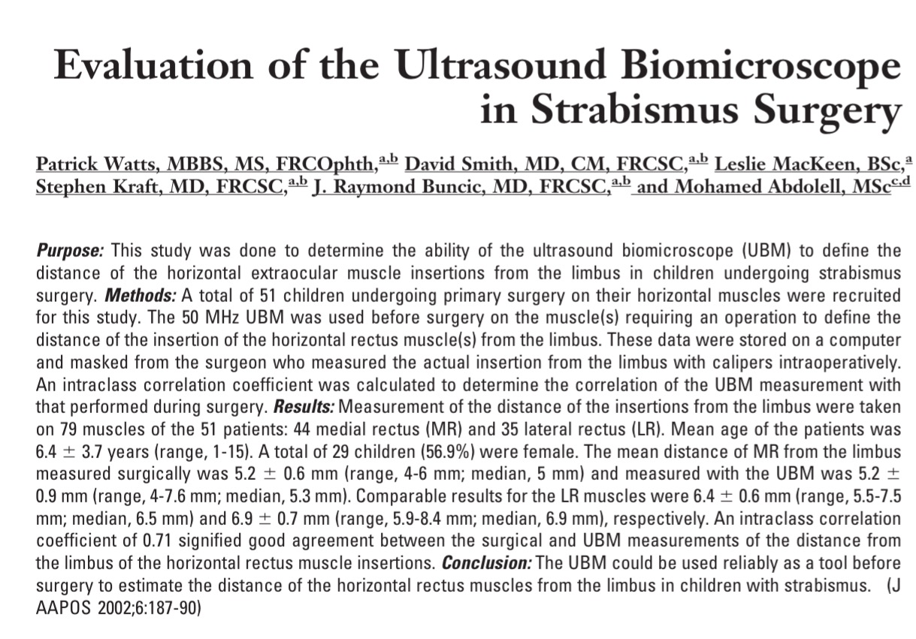
Notes:
UBM, Horizontal, Primary (virgin)
51 children, 79 ms
Intraclass correlation coefficient 0.71 (GOOD AGREEMENT)
UBM is a reliable tool

Slide 4
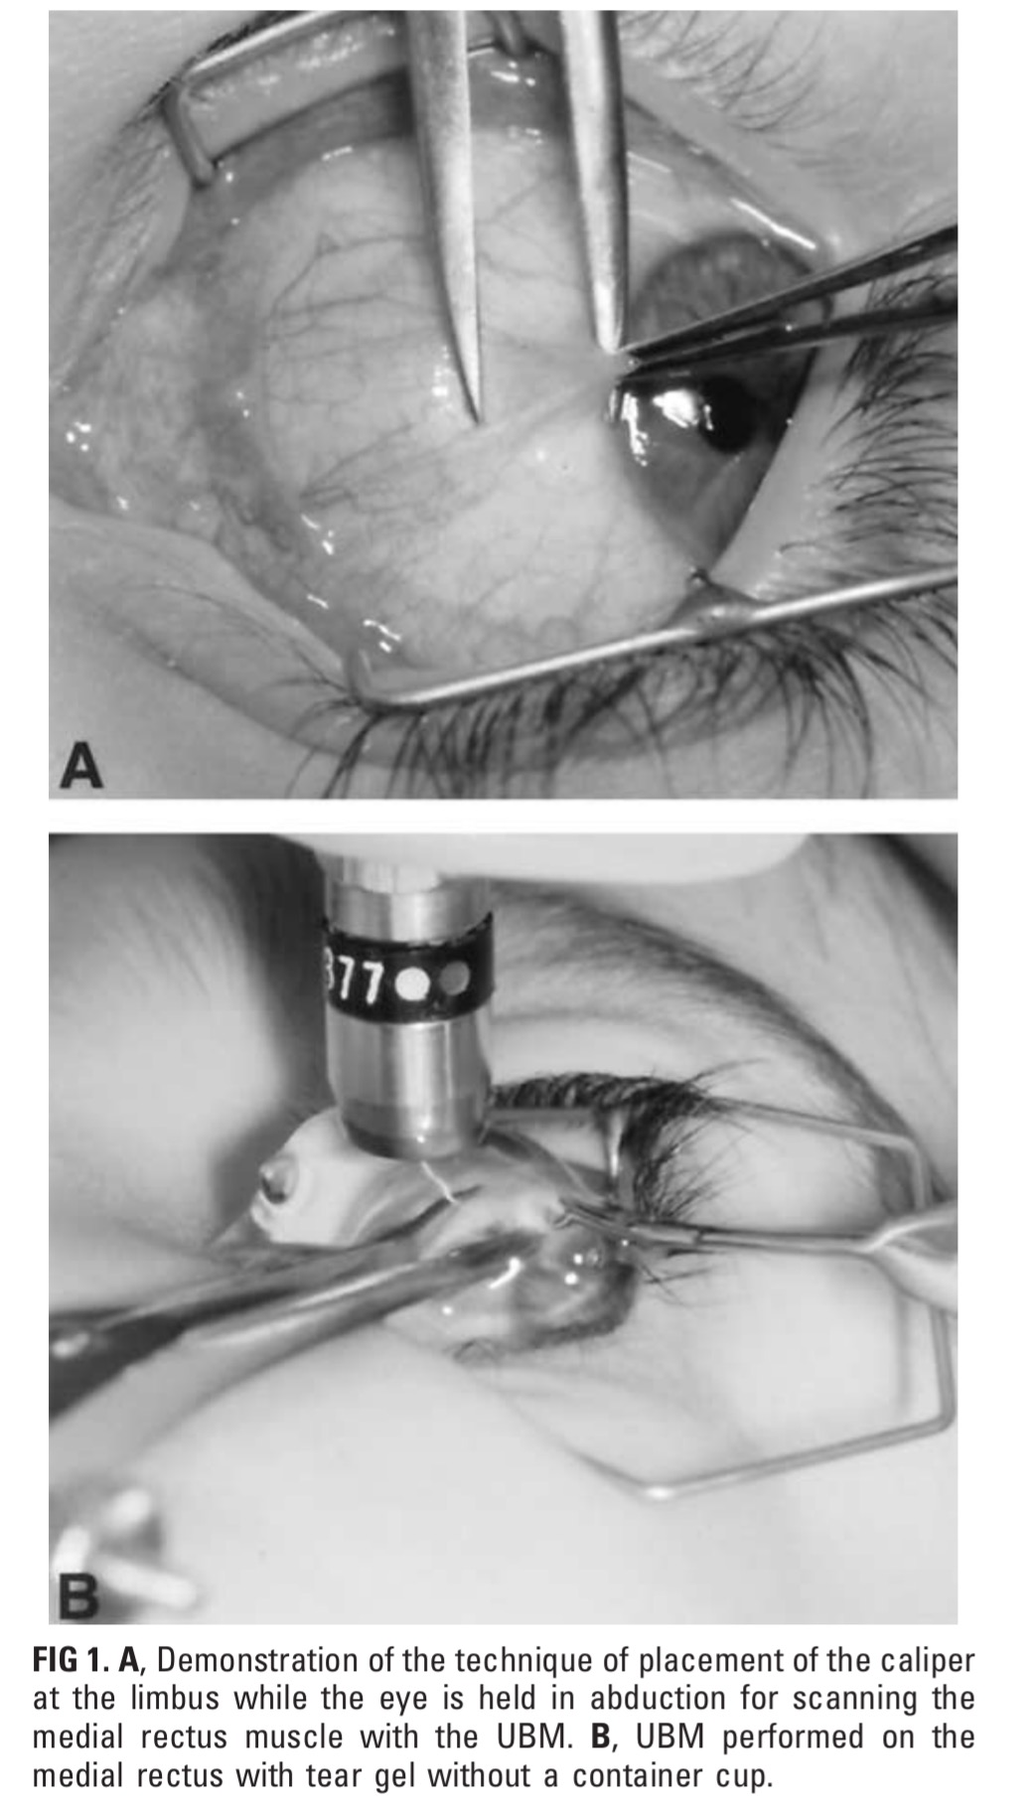
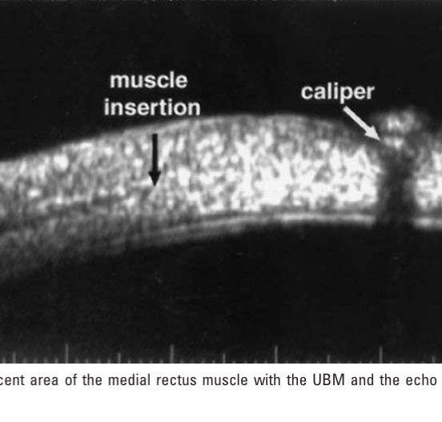
Notes:
microcornea, sclerocornea, and corneal pannus, difficult to define a clear limbus, were excluded.
GA, 60db gain, oscilations perp to limbus (axial cross section of insertion)
Calipre gives clear landmark (4mm MR, 5mm LR)
Calipre function on UBM

Slide 5
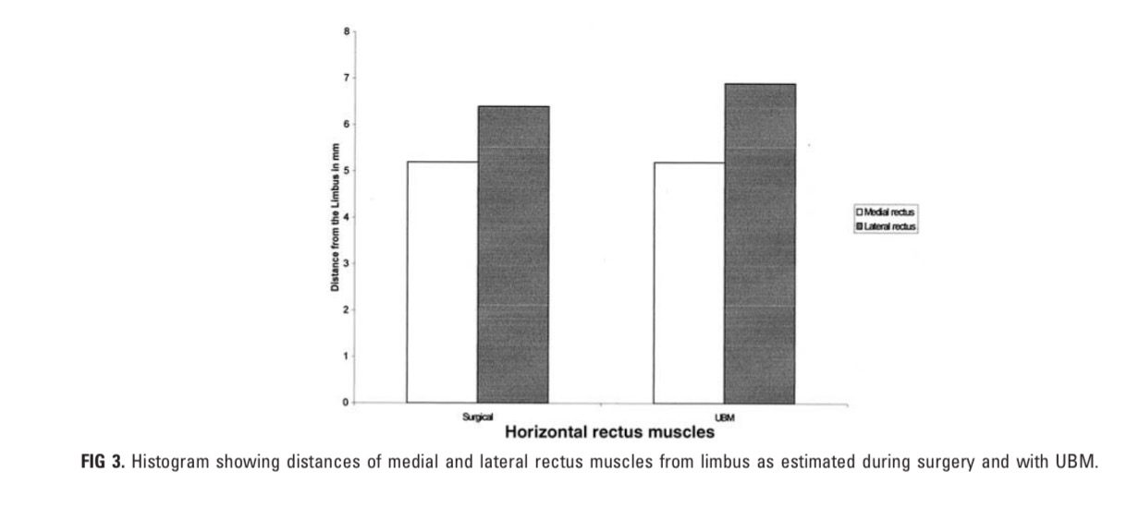
Results
44 MR and 35 LR
The ICC calculated to compare the reliability
Values between 0.81 and 1.00 are considered excellent and those between 0.61 to 0.80 are good
0.71, good intraclass correlation coefficient
UBM slightly overestimated those measured at surgery, a variation due perhaps to the resolving power of the UBM or to the inaccuracy of the technique

Slide 6
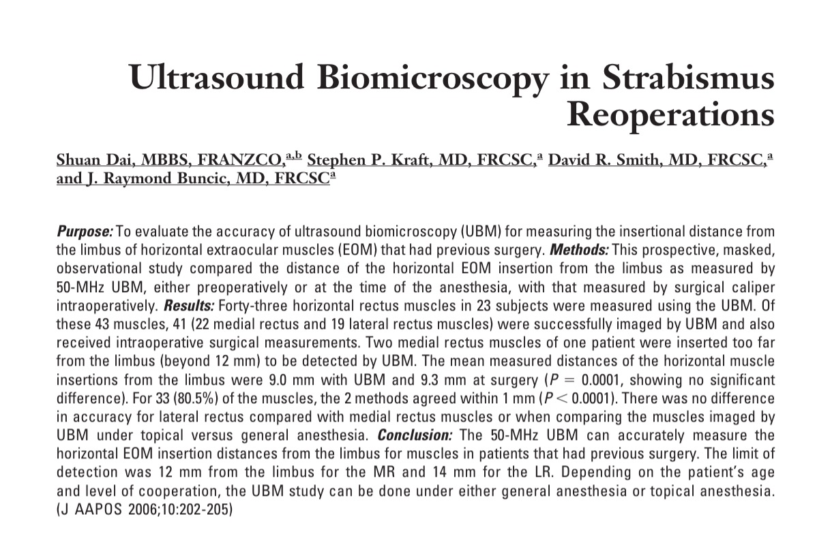

Slide 7
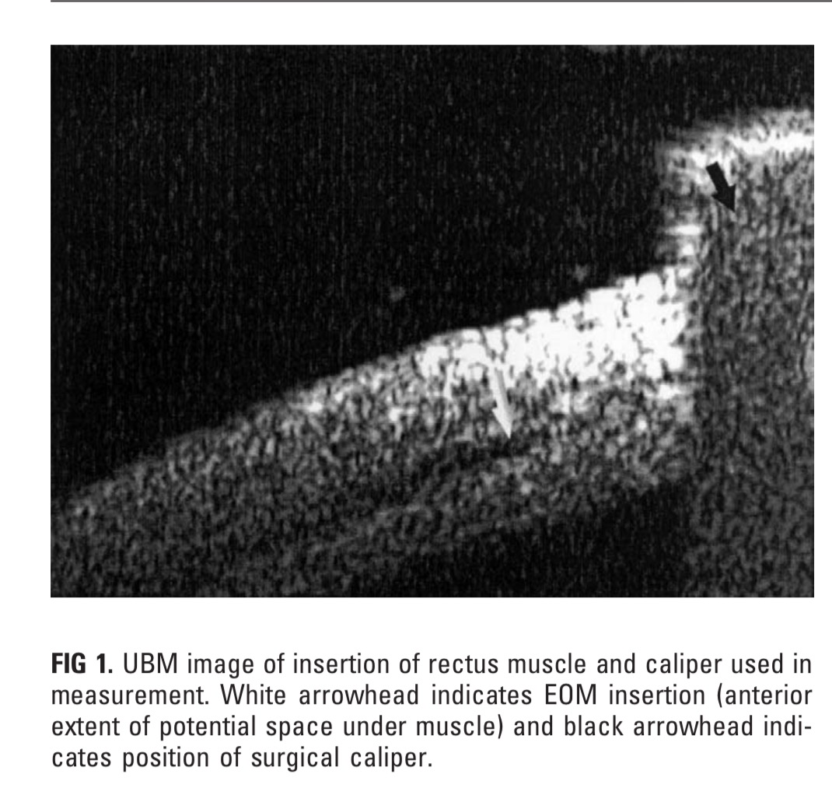
Notes:
Field of view is limited to 5 mm or less
Potential space between muscle and sclera
GA, and topical in 14 and older

Slide 8
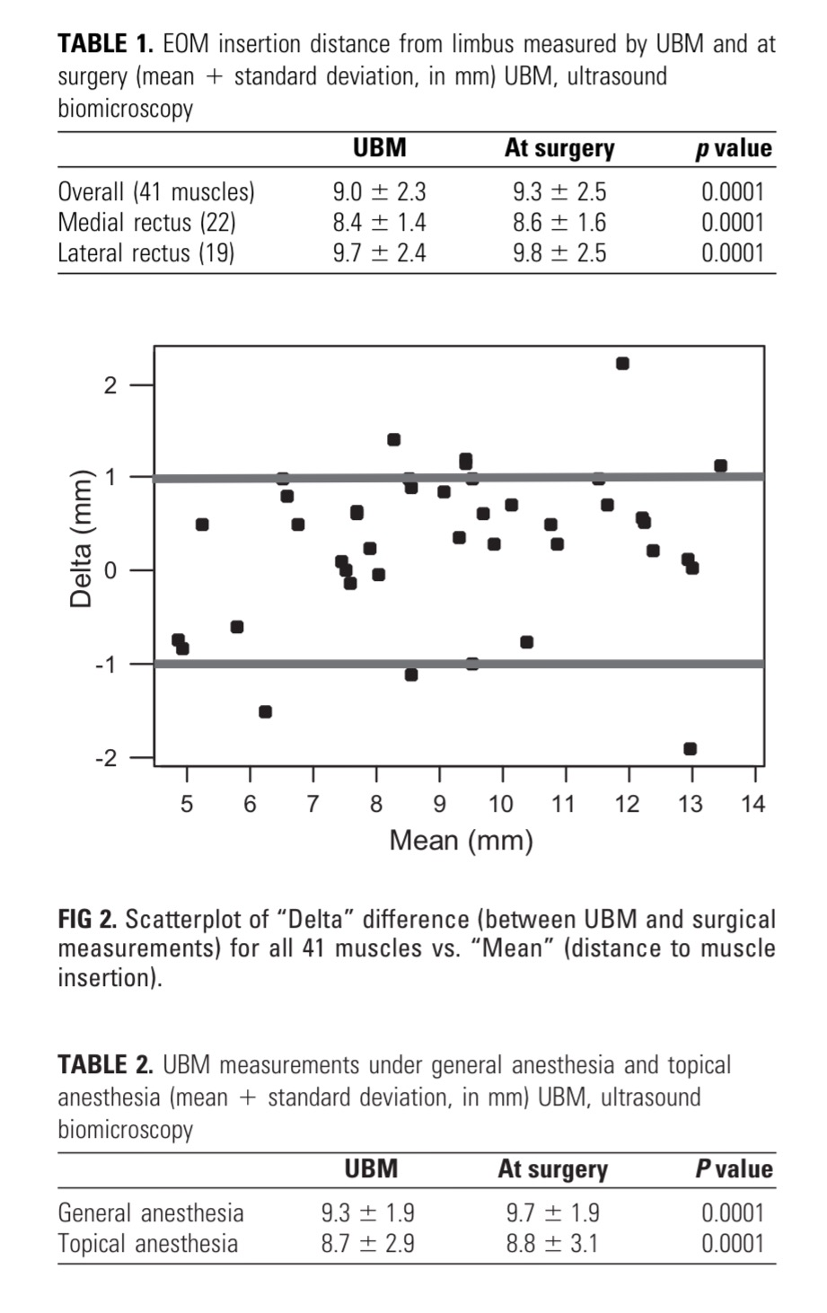

Slide 9
Interesting facts
The longest horizontal muscle insertion distance from limbus measurable by UBM was 12 mm for the MR and 14 mm for LR
UBM was able to differentiate pseudotendon from the true insertion. The muscle insertion was characterized by a potential space located between the global surface of the muscle and the sclera, and which terminated just behind the insertion into the sclera.
The reflectivity of the pseudotendons was not distinguishable from that of overlying soft tissue and underlying sclera (no potential space).

Slide 10
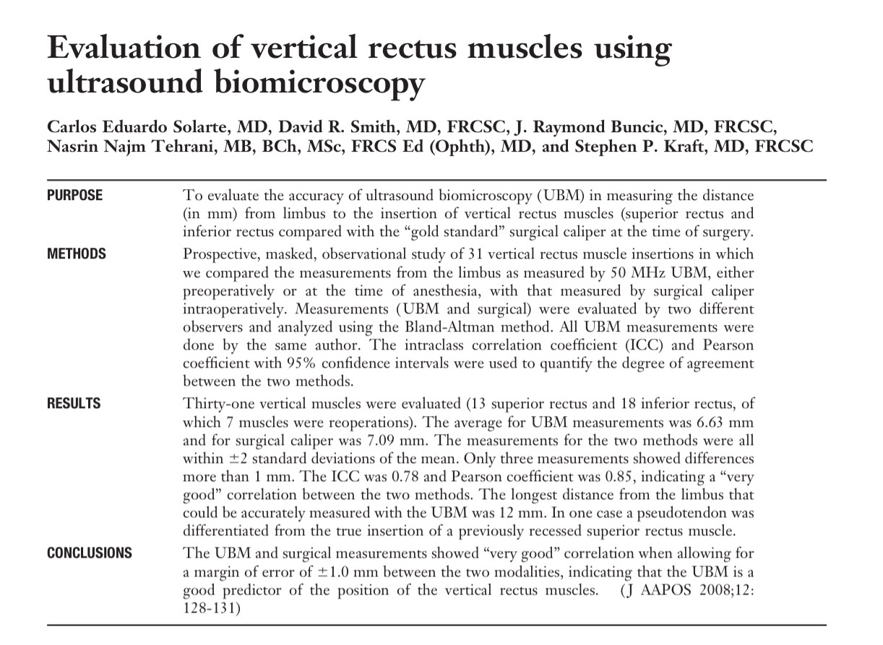

Slide 11
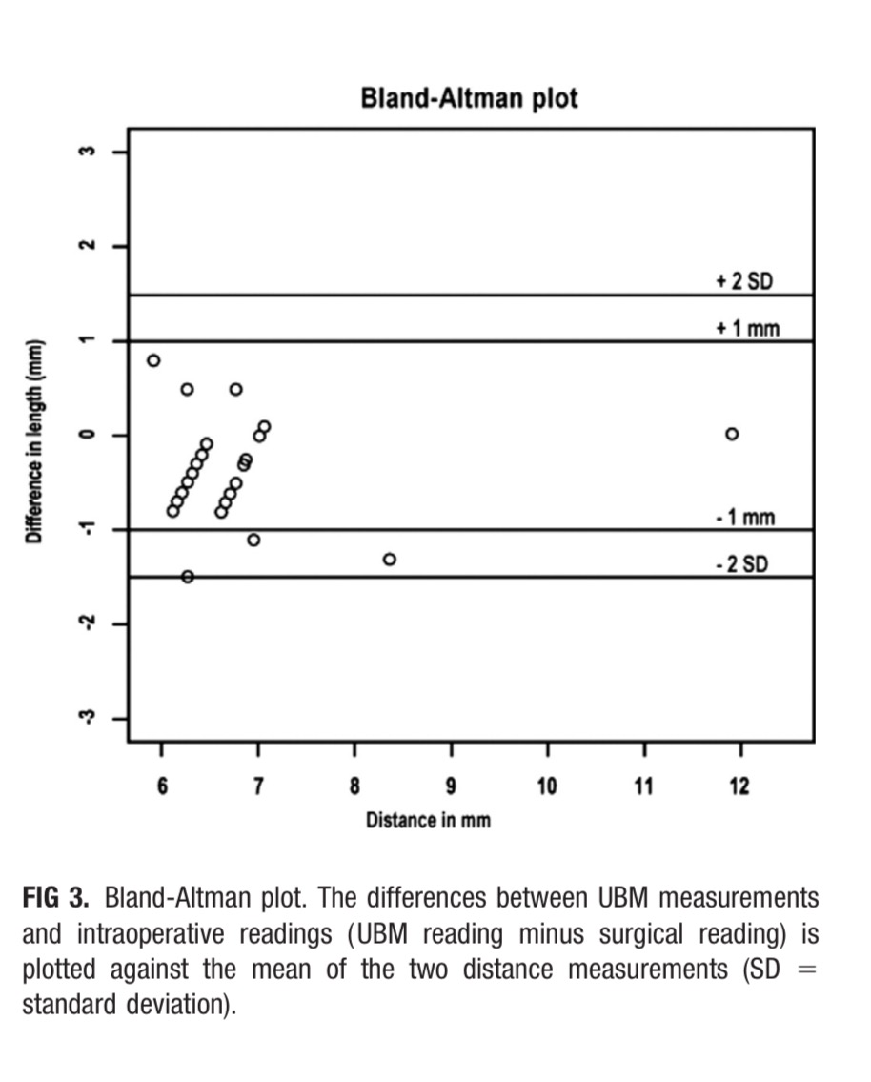
( UBM reading minus surgical measurement) against the mean of the two measurements
clinically acceptable limits of agreement were +/- 􏰀1 mm
According to Bland-Altman plot the degree of agreement was good
The ICC was 0.78, consistent with “very good” correlation between the two methods.

Slide 12
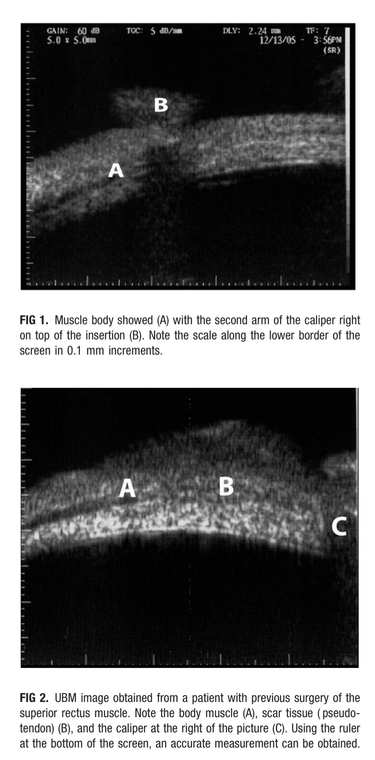
The muscle belly can be visualized by the UBM as a hyperreflective area, which is well delineated.
There is a hyporeflective area under the true muscle that creates a distinct dark linear shadow
In contrast, the pseudotendon was seen as an area that was irregular in shape with a tendency to be highly reflective, and there was no clear linear shadow separating it from the scleral echoes

Slide 13
From the previous 3 studies
Safe, quick, reliable.
suspected lost or slipped muscle after surgery.
characteristics of the muscle body, pseudo tendon.
status of the sclera and choroid underneath the suture site.
Limited view of 5 mm field
Limited to 12 mm in vertical recti and MR, and 14 mm in LR

Slide 14
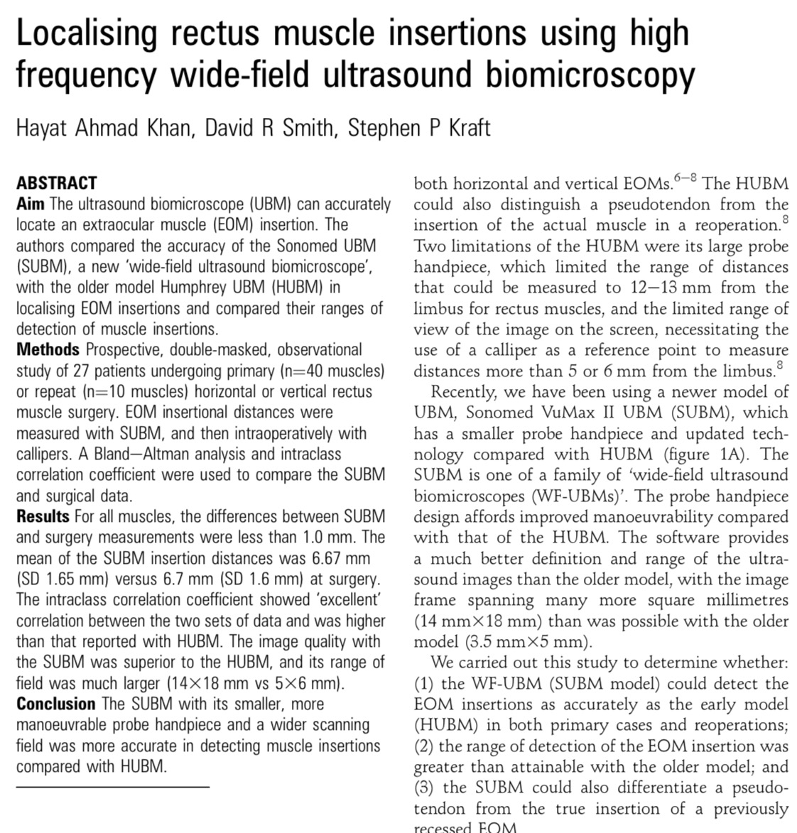

Slide 15
WF-UBM vs older models
The software provides a much better definition
The image frame spanning many more square millimetres (14 mm X 18 mm) than was possible with the older model (3.5 mm X 5 mm).

Slide 16
Questions raised by this study
the WF-UBM could detect the EOM insertions as accurately as the early model (HUBM) in both primary cases and reoperations
the range of detection of the EOM insertion was greater than attainable with the older model
the SUBM could also differentiate a pseudo- tendon from the true insertion of a previously recessed EOM.

Slide 17
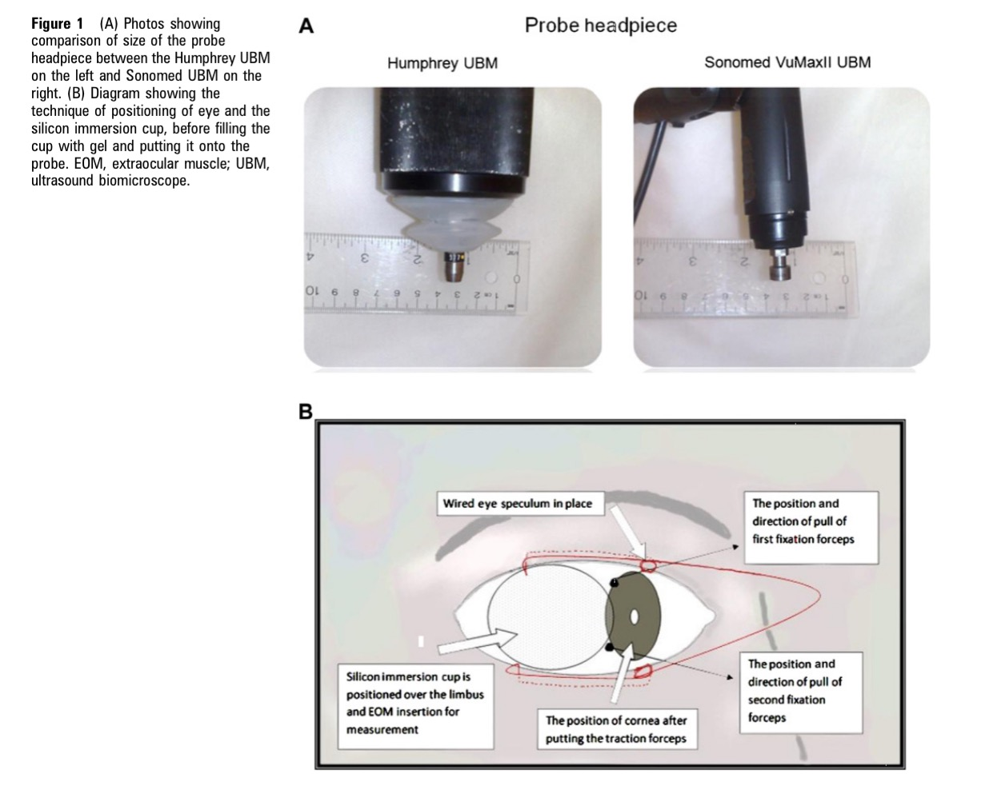

Slide 18
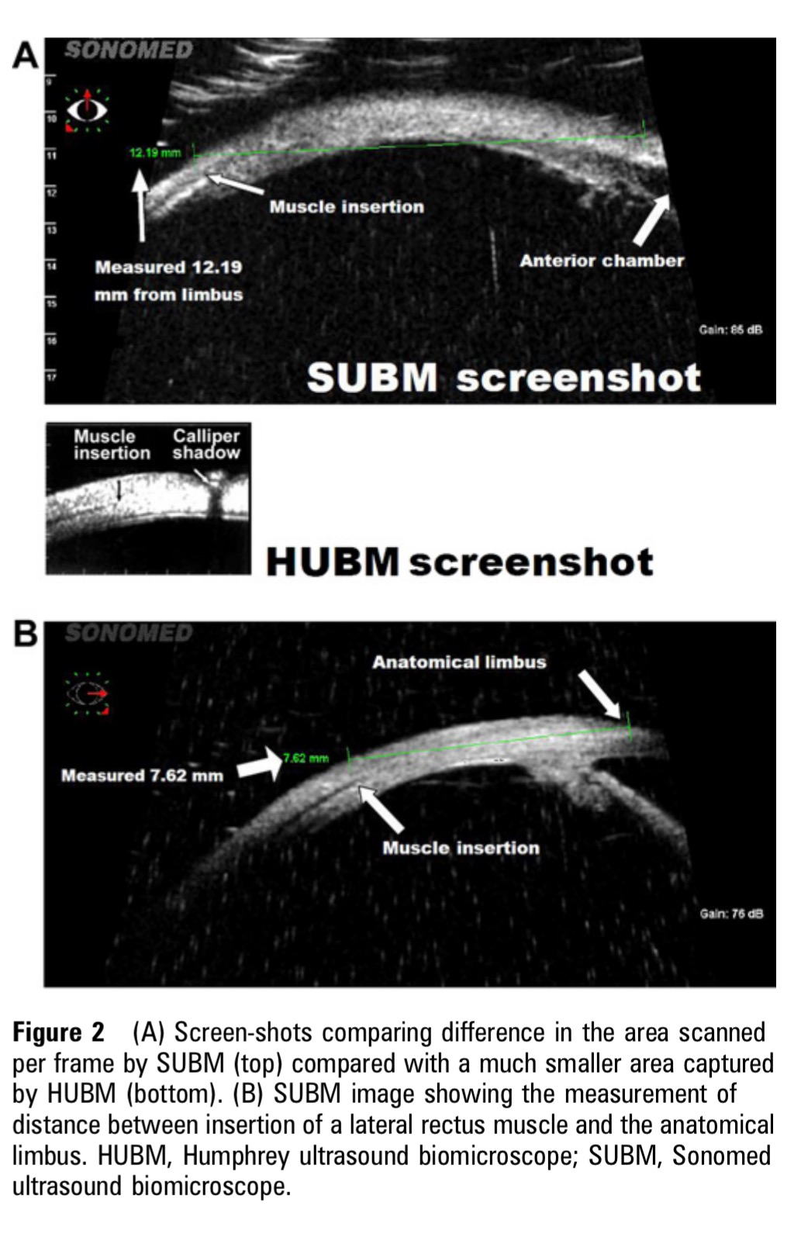
no calliper was needed if the muscle was within 14 mm of the limbus, as the horizontal field of view of the probe is 14 mm

Slide 19
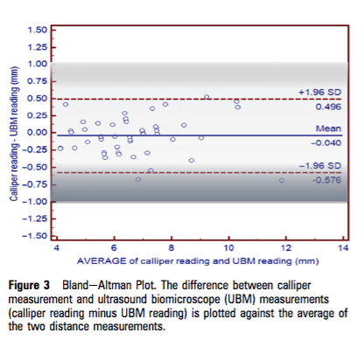
Results
the degree of agreement between the two methods was very good.
All the measurements were within the 1.0mm difference that we considered to be ‘clinically acceptable’.
The interclass correlation coefficient was 0.98, consistent with ‘excellent’ correlation between the two methods of measurement

Slide 20
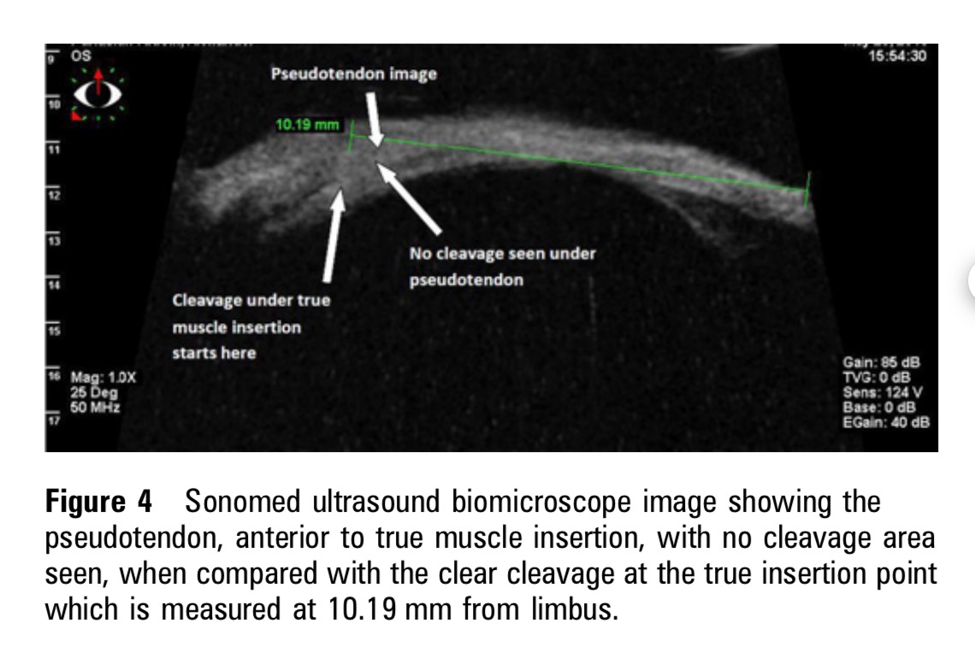
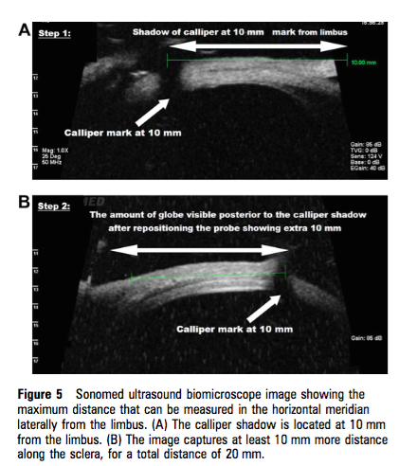
Pseudotendon
Max. distance measured

Slide 21
Information relating to the localisation of this muscle before the start of procedure is vital in planning of surgical approach.
when there is a limitation of movement of an eye within a few days after surgery or after orbit trauma, it is critical to differentiate a slipped muscle from a paretic muscle.
much larger area of capture

